Slide 1
Db2 Database Monitoring Techniques
Speaker: Vaisakh Gopal
IBM Advanced Db2 Support
Time: 27th June 2023 at 3-4 pm IST
Place – (https://ibm.webex.com/meet/vaisakh.gopal)

Slide 2
The term database monitoring refers to the tasks associated with examining the operational status of your database. Database monitoring is a vital activity for the maintenance, performance and health of your database management system. To facilitate monitoring, the database management system collects information from the database manager, its databases, and any connected applications. With this information you can perform the following types of tasks, and more: -Forecast hardware requirements based on database usage patterns. -Analyse the performance of individual applications or SQL queries. -Track the usage of indexes and tables. -Pinpoint the cause of poor system performance. -Assess the impact of optimization activities
Database Monitoring

Slide 3
Agenda Monitoring Techniques - Snapshot Monitoring - In-memory Metrics Interfaces - Event Monitors - db2mon.sh - Db2 Problem Determination (db2pd) Db2 Support – Problem Analysis and Monitoring

Slide 4
Snapshot Monitoring
Capture information about the database and any connected applications at a specific time
Useful for obtaining the current status of a system
Some data is collected from system monitor hence monitor switches should be turned on
Collection of system monitor data is done only when the Database is active
Must have SYSADM, SYSCTRL, SYSMAINT, or SYSMON authority to capture a database snapshot.
These are the system monitor switches that control the collection of system monitor data
Buffer pool (DFT_MON_BUFPOOL)
Lock (DFT_MON_LOCK)
Sort (DFT_MON_SORT)
Statement (DFT_MON_STMT)
Table (DFT_MON_TABLE)
Timestamp (DFT_MON_TIMESTAMP)
Unit of work (DFT_MON_UOW)
© Copyright IBM Corporation 2009, 2020

Slide 5
Example
Snapshot for all databases
db2 get snapshot for all databases
To collect bufferpool data
db2 update dbm cfg using DFT_MON_BUFPOOL ON
db2 get snapshot for bufferpools on dbname
To collect information for applications for all database partitions
db2 get snapshot for all applications global
To collect locks data
db2 update dbm cfg using DFT_MON_LOCKS ON
db2 get snapshot for locks on dbname
Full list - https://www.ibm.com/docs/en/db2/11.5?topic=monitor-snapshot-clp-commands
© Copyright IBM Corporation 2009, 2020

Slide 6
In-memory Metrics Interfaces
The in-memory metrics monitor infrastructure is separate from the snapshot monitor infrastructure, which was the primary monitor infrastructure for prior releases to 9.7.
Data monitored through SQL Table functions and views
The in-memory metrics infrastructure has lower contention and resource usage compared to the snapshot infrastructure.
Snapshot is controlled at instance level whereas in memory metrics is controlled at database or WLM level
Reports more monitor elements than snapshots
These are the configuration parameters that control collection of data
Request metrics (MON_REQ_METRICS)
Activity metrics (MON_ACT_METRICS)
Object metrics (MON_OBJ_METRICS)
© Copyright IBM Corporation 2009, 2020

Slide 7
List of Monitoring Table Functions
Activities
• MON_GET_ACTIVITY
• MON_GET_ACTIVITY_DETAILS
• MON_GET_PKG_CACHE_STMT
• MON_GET_PKG_CACHE_STMT_DETAILS
Data Objects
• MON_GET_BUFFERPOOL
• MON_GET_TABLESPACE
• MON_GET_CONTAINER • MON_GET_TABLE
• MON_GET_INDEX
Full list -https://www.ibm.com/docs/en/db2/11.5?topic=views-monitor-procedures-functions
Locking
• MON_GET_LOCKS • MON_GET_APPL_LOCKWAIT
Routines
• MON_GET_ROUTINE • MON_GET_ROUTINE_DETAILS • MON_GET_ROUTINE_EXEC_LIST
• MON_GET_SECTION_ROUTINE
© Copyright IBM Corporation 2009, 2020

Slide 8
Examples of Monitoring Table Functions
To find top 10 slowest SQLs from package cache according to average statement exec time
db2 "SELECT cast(stmt_text as varchar(50)) as statement, dec((cast(stmt_exec_time as float) /num_executions/1000),10,5) as avg_stmt_exec, rows_read, rows_returned, rows_modified FROM TABLE(MON_GET_PKG_CACHE_STMT ( '', NULL, NULL, -2)) where num_executions != 0 order by avg_stmt_exec desc fetch first 10 rows only”
To find current locks on the system
db2 "select * from table(mon_get_locks(null,-2))”
Waiting locks
db2 "select * from table(MON_GET_APPL_LOCKWAIT(null,-2))”
To get details of Current activities in the system
db2 "SELECT t.application_handle, t.uow_id, t.activity_id,VARCHAR(t.stmt_text, 256) as stmt_text FROM table(MON_GET_ACTIVITY(NULL, -1)) as t”
© Copyright IBM Corporation 2009, 2020

Slide 9
Examples of Monitoring Views
Scenario – Identify applications with Table scans
SELECT APPLICATION_HANDLE, ROWS_READ_PER_ROWS_RETURNED FROM SYSIBMADM.MON_CONNECTION_SUMMARY;
Scenario – Check Bufferpool utilization
SELECT BP_NAME, DATA_HIT_RATIO_PERCENT, INDEX_HIT_RATIO_PERCENT, XDA_HIT_RATIO_PERCENT, COL_HIT_RATIO_PERCENT FROM SYSIBMADM.MON_BP_UTILIZATION
Scenario – Identify Top 5 Current Running SQL queries
SELECT ELAPSED_TIME_SEC, ACTIVITY_STATE, ACTIVITY_TYPE, APPLICATION_HANDLE FROM SYSIBMADM.MON_CURRENT_SQL ORDER BY ELAPSED_TIME_SEC DESC FETCH FIRST 5 ROWS ONLY;
Full list- https://www.ibm.com/docs/en/db2/11.5?topic=views-monitor
© Copyright IBM Corporation 2009, 2020

Slide 10
Event Monitors
There are many times when you need to capture information about the state of your system at exactly the time that a specific event occurs.
Event Monitors serve this purpose
Capture point-in-time information related to different kinds of events that take place in your system. Example – when a lock timeout occurs
Event monitors collect data for different events in the system
DB2DETAILDEADLOCK(deprecated) event monitor is created by default for each newly created database.
Event monitor data can be written to
Regular Tables
Unformatted Event Tables
Files
Named Pipes
© Copyright IBM Corporation 2009, 2020

Slide 11
Event Monitors
LOCKING
STATEMENTS
ACTIVITIES
UNIT OF WORK
PACKAGECACHE
CONNECTIONS
DATABASE
BUFFERPOOLS
TABLESPACES
TABLES
STATISTICS
THRESHOLD VIOLATIONS
CHANGE HISTORY
https://www.ibm.com/docs/en/db2/11.5?topic=monitors-types-events-which-event-capture-data
© Copyright IBM Corporation 2009, 2020

Slide 12
To create event monitor
CREATE EVENT MONITOR evmon-name FOR eventtype
-data to be collected needs to be specified here
To activate event monitor to collect data
SET EVENT MONITOR evmon-name STATE 1
To deactivate event monitor
SET EVENT MONITOR evmon-name STATE 0
To view active event monitors
SELECT substr(evmonname, 1, 30) as evmon_name FROM syscat.eventmonitors WHERE event_mon_state(evmonname) = 1
© Copyright IBM Corporation 2009, 2020

Slide 13
Example
Create an event monitor for LOCKING called MYLOCKS writing to a regular table db2 “CREATE EVENT MONITOR MYLOCKS FOR LOCKING WRITE TO TABLE”
5 tables are created
LOCK_ACTIVITY_VALUES_MYLOCKS
LOCK_PARTICIPANT_ACTIVITIES_MYLOCKS
LOCK_PARTICIPANTS_MYLOCKS
LOCK_MYLOCKS
CONTROL_MYLOCKS
Can control what data is collected when creating itself
Activate Event Monitor
db2 set event monitor MYLOCKS state 1
© Copyright IBM Corporation 2009, 2020

Slide 14
In Session 1
db2 + c “insert into t1 values(9)”
In Session 2
db2 set isolation level=RR; db2 "select * from t1"
It will give Lock Timeout Error
Query the lock monitor tables. It will give the lock participant details
db2 "SELECT DISTINCT CAST(STMT_TEXT AS VARCHAR(40)) STMT, LP.PARTICIPANT_NO,VARCHAR(LP.APPL_NAME,10) APPL_NAME, LP.APPLICATION_HANDLE, LP.LOCK_MODE_REQUESTED,LP.PARTICIPANT_TYPE FROM LOCK_PARTICIPANT_ACTIVITIES_MYLOCKS AS LPA JOIN LOCK_PARTICIPANTS_MYLOCKS AS LP ON LPA.EVENT_ID = LP.EVENT_ID”
© Copyright IBM Corporation 2009, 2020

Slide 15
Unformatted Event Tables
Example
db2 "CREATE EVENT MONITOR myevmon FOR LOCKING WRITE TO UNFORMATTED EVENT TABLE (TABLE UELOCKS IN TBSP32K) ” db2 “SET EVENT MONITOR myevmon STATE 1”
Reproduce the locking scenario
Format the data into Tables
db2 "CALL EVMON_FORMAT_UE_TO_TABLES ('LOCKING', NULL, NULL, NULL, NULL, NULL, NULL, -1, 'SELECT * FROM UELOCKS’)”
Parse Data
SELECT DISTINCT CAST(STMT_TEXT AS VARCHAR(40)) STMT, LP.PARTICIPANT_NO,
VARCHAR(LP.APPL_NAME,10) APPL_NAME, LP.LOCK_MODE_REQUESTED,
LP.PARTICIPANT_TYPE
FROM LOCK_PARTICIPANT_ACTIVITIES AS LPA
JOIN LOCK_PARTICIPANTS AS LP ON LPA.XMLID = LP.XMLID
© Copyright IBM Corporation 2009, 2020

Slide 16
db2mon
db2mon is a set of Db2® command line processor (CLP) scripts that use Db2 lightweight in-memory monitoring interfaces to collect monitoring data for a specific period.
Monitors database activity for a set amount of time (default = 30 seconds) and provides various metrics in a detailed report section as the output.
Script available in sqllib/samples/perf
db2mon checks for a user temporary table space and the minimum required values for MON_ACT_METRICS and MON_REQ_METRICS
Usage
db2mon.sh MyDatabaseName > db2mon.out
db2 -tvf db2mon.sql > db2mon.out
© Copyright IBM Corporation 2009, 2020

Slide 17
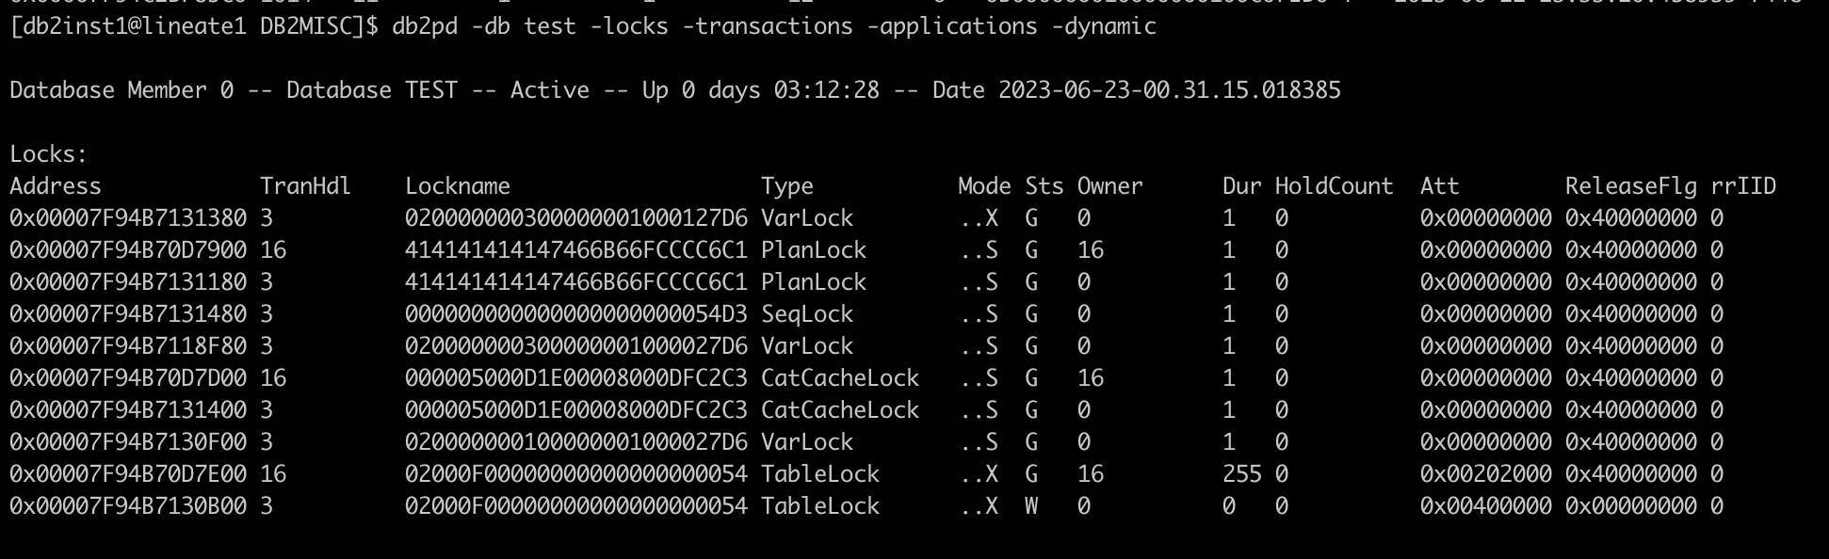
db2pd
Retrieves information from the Db2 database system memory sets.
There is no minimum connection requirement. However, if a database scope option is specified, that database must be active before the command can return the requested information.
Example – to check locks and associated applications
db2pd -db databasename -locks -transactions -applications –dynamic
© Copyright IBM Corporation 2009, 2020

Slide 18
Waiting locks
db2pd -wlocks -db test
Application info
db2pd -apinfo app-handl -db test
Mapping an application to a dynamic SQL statement
db2pd -applications -dynamic
https://www.ibm.com/docs/en/db2/11.5?topic=tools-db2pd

Slide 19
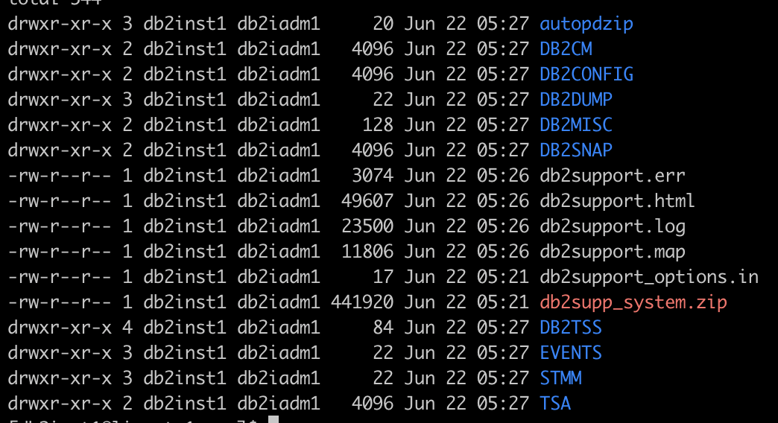
db2support
Why Support analysts ask for db2support file?
Db2support Collects environment data about either a client or server machine and places the files that contain system data into a compressed file archive.
Standard usage
db2support . –d dbname –c –s
Contents of db2support
© Copyright IBM Corporation 2009, 2020

Slide 20
DB2DUMP - Contains information from db2dump directory
DB2CONFIG - Different configuration such as DB and DBM CFG etc
DB2SNAP – Details about Instance and some db2pd outputs
DB2MISC- OS info and memory details
© Copyright IBM Corporation 2009, 2020

Slide 21

Questions ?

